Slide 1
CASE STUDY
MODELLING AND SIMULATION OF A HEATING SYSTEM OF A SINGLE-FAMILY HOUSE
Presented By:
Eduardo Guandulain Juárez
Muhammad Munam Uddin Farooqui
Rohit Arunachalam Gopinath
Yuganshu Wadhwa
Nnamdi Ogbonnaya Odii
1

Slide 2
AGENDA
Introduction
The Refrigeration Cycle
Heat Pump and Building Plant: UniSim
PRBS Tests
System Identification
Simulink Model and PI Control
OPC DA: Connecting Plant and Controller
Simulation Results
Testing Different Gains with the Plant
Testing Different Lags with the Plant
Eventual PI Controller
Conclusions and Future Possibilities

Slide 3
PROBLEM STATEMENT
The objective of this case study is to model and control a heating system for a single-family house.
SOLUTION APPROACH
Development of a plant model as well as an advanced PI controller in Simulink using system identification.
Using the developed controller to control the heat pump plant in UniSim via OPC DA communication channel.
WHY HEAT PUMP?
Economic reasons / cost saving.
Lower carbon footprint.
Energy efficiency - as heat pump transfers heat rather than generate it and produces 3-4 units of electricity for every unit of electricity consumed.

Slide 4
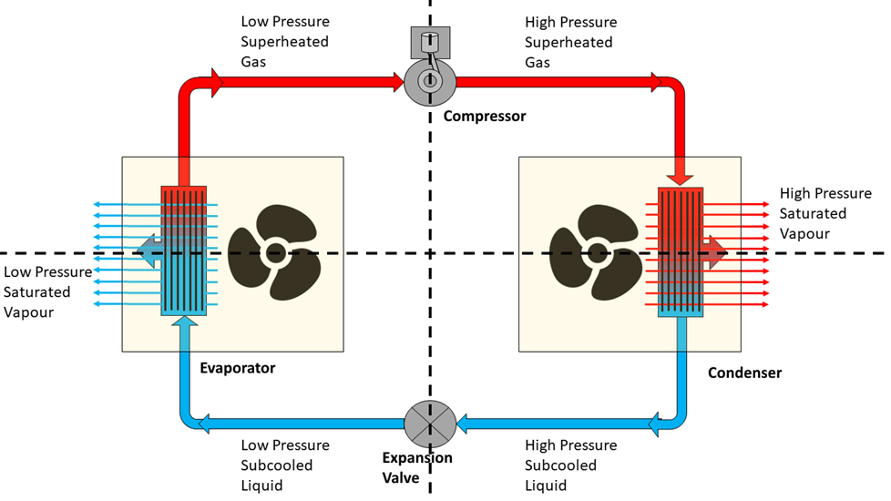
THE REFRIGERATION CYCLE
1
4
2
https://www.torr-engineering.com/the-refrigeration-cycle/
3

Slide 5
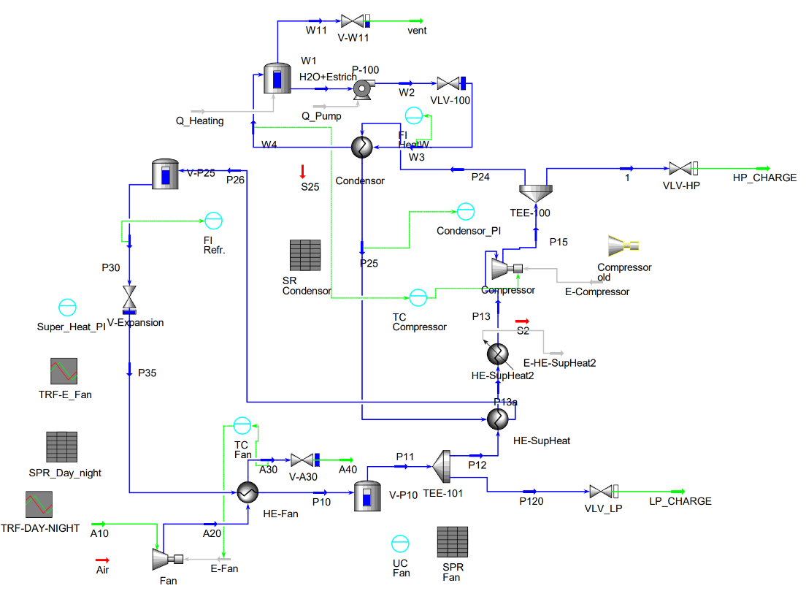
HEAT PUMP MODEL: UNISIM
2
1
3
4

Slide 6
PSEUDO-RANDOM BINARY SEQUENCE
(PRBS)

Slide 7
PSEUDO-RANDOM BINARY SEQUENCE (PRBS) TESTS
Why?
Dynamic Behavior of the system
Accurate Model
Outcome
Linear Transfer Function
Notes:
PRBS Test is widely used method
in system identification.
In our case we utilized the PRBS Tests to achieve 2 Main objectives.
1. Understand the Dynamic Behavior of the Heat Pump at different Stationary Points
2. And to develop an accurate model of the system in Simulink.
After doing the PRBS Tests we were able to establish the linear transfer function

Slide 8
PSEUDO-RANDOM BINARY SEQUENCE (PRBS)TESTS
T_Out (°C) | PV_Stationary (°C) | OP_Stationary (%)
-12 | 33.902 | 97.0368
-11 | 33.7435 | 76.6963
-10 | 33.59 | 62.64
-9 | 33.4265 | 52.4591
-8 | 33.26 | 44.62
-5 | 32.62 | 30.45
-2 | 32.5 | 22.05
-1 | 32.17 | 19.96
0 | 31.92 | 18
1 | 31.84 | 16
2 | 31.69 | 14.45
Min OP: 100%
Min OP: 10%
Notes:
We performed PRBS tests across a range of outside temperatures starting from +2 to -12 degrees Celsius.
It helped us understand how to system behaves under various conditions covering both min and max operating points.

Slide 9
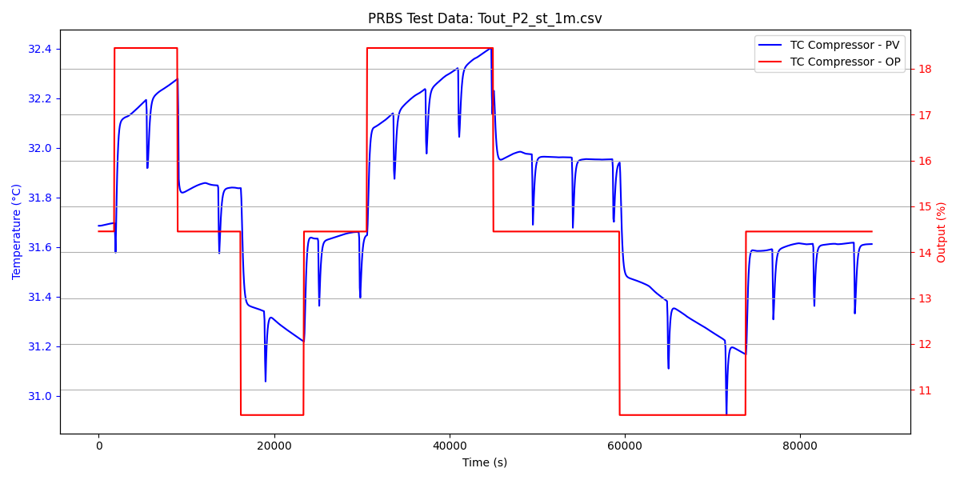
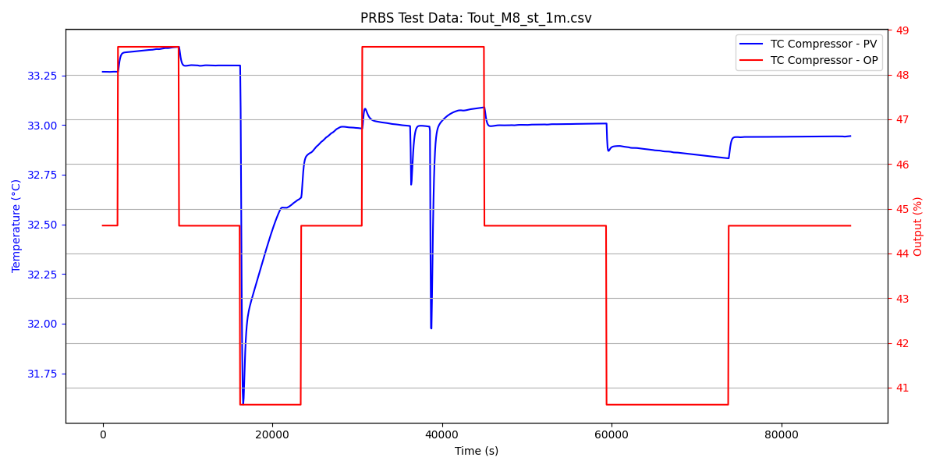
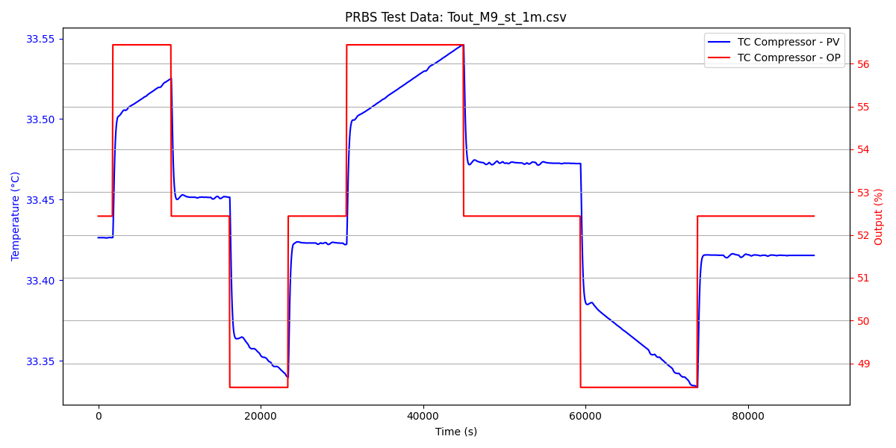
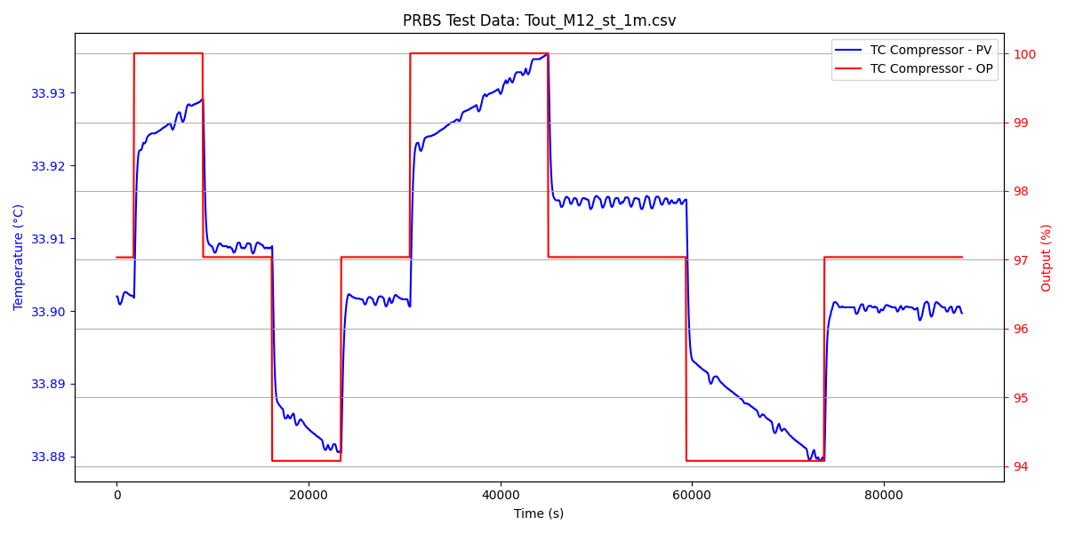
PSEUDO-RANDOM BINARY SEQUENCE (PRBS)TESTS
Notes:
We began by running the unisim plant model with its inbuilt controller until it reached a stables operating point.
Once stable we conducted tests by applying a step change of +4 and -4 in the OP, during which we recorded the corresponding PV values
These steps allowed us to establish the steady state relationship between OP & PV
At certain temperatures we observed some spikes which was a characteristic behavior of the model.

Slide 10
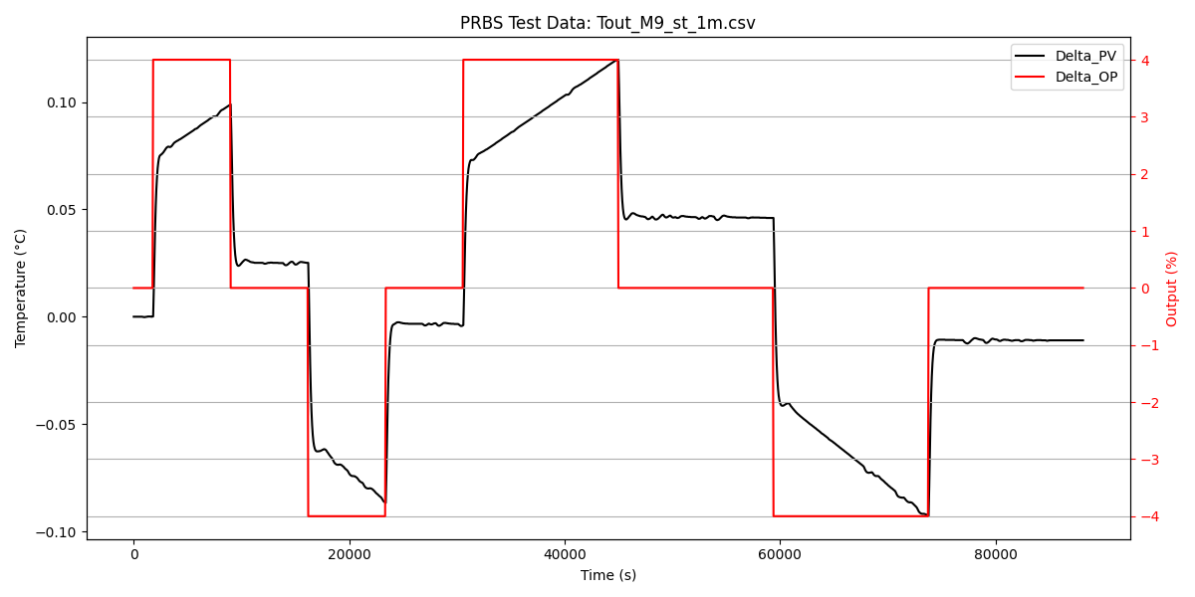
PSEUDO-RANDOM BINARY SEQUENCE (PRBS)TESTS
Notes:
Each of the PRBS tests were run for 24 hours. We then converted the recorded values into delta values which represent the change in OP and PV
These delta values were then used further during the system identification process.

Slide 11
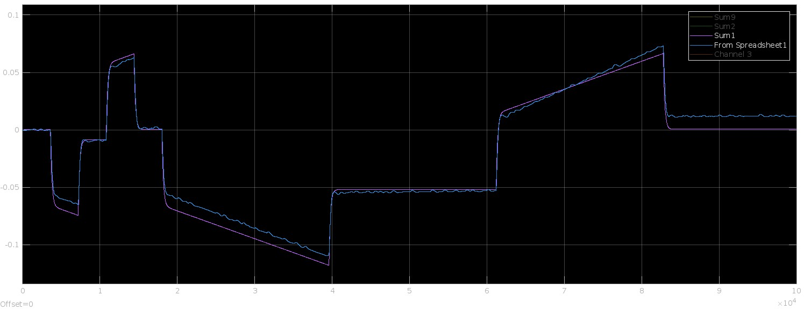
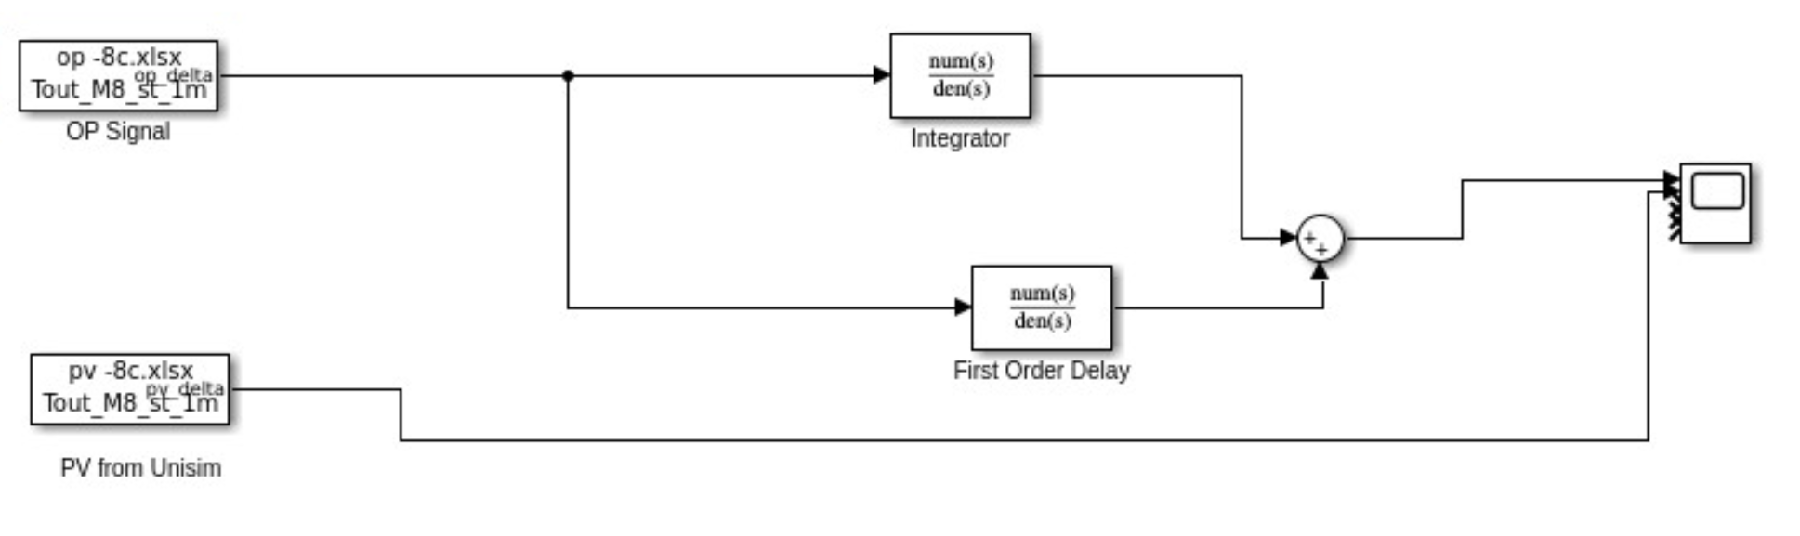
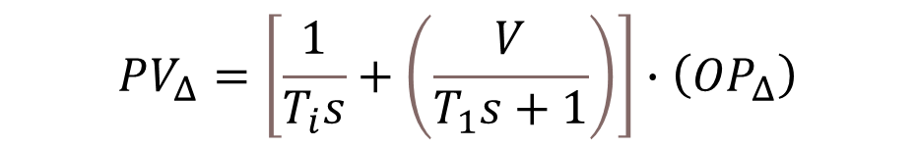
SYSTEM IDENTIFICATION
$$PV_{Δ}=\left[\frac{1}{T_{i}s}+\left(\frac{V}{T_{1}s+1}\right)\right]∙\left(OP_{Δ}\right)$$
From Unisim
From Simulink
PV
Timestamp

Slide 12
SYSTEM IDENTIFICATION – PARAMETER ESTIMATION
T_Out (°C) | PV_Stationary (°C) | OP_Stationary (%) | V | T₁ (s) | T_{i} (s) | T_{i} (days)
-12 | 33.902 | 97.0368 | 0.01 | 9784.27 | 4025452 | 46.59
-11 | 33.7435 | 76.6963 | 0.01 | 242.77 | 1838599 | 21.28
-10 | 33.59 | 62.64 | 0.0165 | 180 | 1650000 | 19.09722
-9 | 33.4265 | 52.4591 | 0.019 | 250.49 | 1073817 | 12.42844
-8 | 33.26 | 44.62 | 0.025 | 250 | 949536 | 10.99
-5 | 32.62 | 30.45 | 0.06 | 300 | 550000 | 6.365741
-2 | 32.5 | 22.05 | 0.08 | 300 | 400000 | 4.62963
-1 | 32.17 | 19.96 | 0.08 | 300 | 220000 | 2.546296
0 | 31.92 | 18 | 0.13 | 300 | 300000 | 3.472222
1 | 31.84 | 16 | 0.11 | 300 | 280000 | 3.240741
2 | 31.69 | 14.45 | 0.1 | 300 | 250000 | 2.893519

Slide 13
SYSTEM IDENTIFICATION – PARAMETER ESTIMATION

Slide 14
SYSTEM IDENTIFICATION – PARAMETER ESTIMATION

Slide 15
SYSTEM IDENTIFICATION – NON LINEAR STATIONARY CURVE

Slide 16
SYSTEM IDENTIFICATION – EFFECT OF DISTURBANCE Tout

Slide 17
SYSTEM IDENTIFICATION – SETPOINT TRACKING
OP

Slide 18
PLANT MODEL

Slide 19
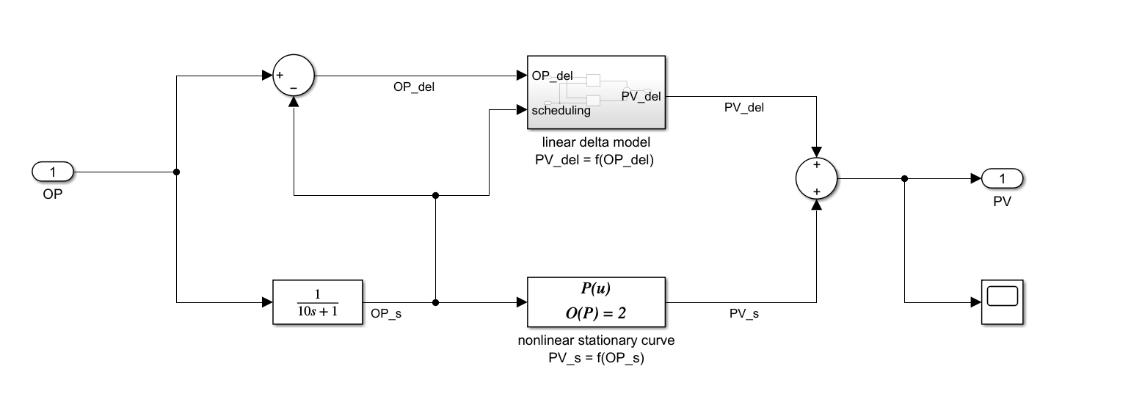


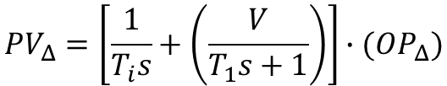

Linear Delta Model
PLANT MODEL
$$PV=f\left(OP\right)$$
PV
$$PV=PV_{S}+PV_{Δ}$$
$$OP=OP_{S}+OP_{Δ}$$
OP
Linear Delta Model
$$PV_{Δ}=\left[\frac{1}{T_{i}s}+\left(\frac{V}{T_{1}s+1}\right)\right]∙(OP_{Δ})$$
Nonlinear Stationary Model
Nonlinear Stationary Model

Slide 20

Linear Delta Model
$$OP_{Δ}=OP−OP_{S}$$
Nonlinear Stationary Model

Slide 21
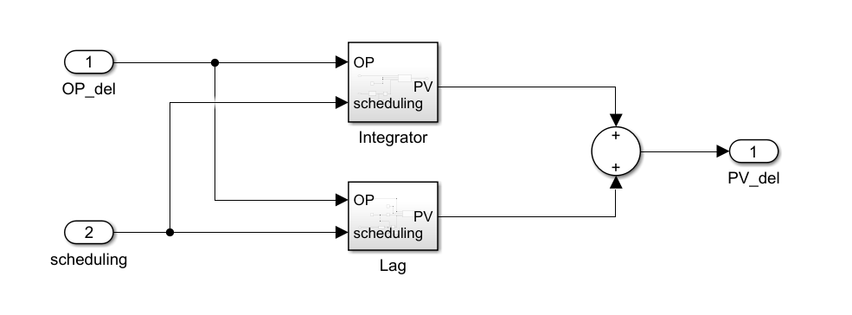

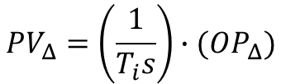
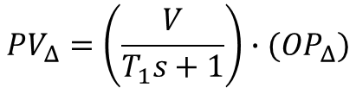
Linear Delta Model
$$PV_{Δ}=\left(\frac{1}{T_{i}s}\right)∙(OP_{Δ})$$
$$T_{i}=511.04 OP^{2}−14301 OP+4053692$$
$V=−3e^{−07}OP^{3}+3e^{−07}OP^{2}−0.0065OP+0.194$4
$$T_{1}=300$$
Nonlinear Stationary Model
$$PV_{Δ}=\left(\frac{V}{T_{1}s+1}\right)∙(OP_{Δ})$$

Slide 22
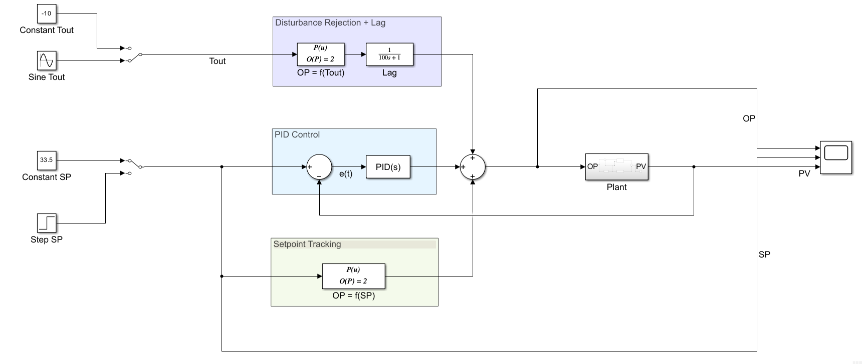
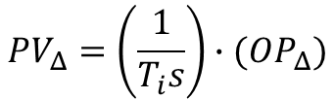
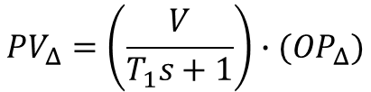

$$PV_{Δ}=\left(\frac{1}{T_{i}s}\right)∙(OP_{Δ})$$
$$T_{i}=511.04 OP^{2}−14301 OP+4053692$$
$V=−3e^{−07}OP^{3}+3e^{−07}OP^{2}−0.0065OP+0.194$4
$$T_{1}=300$$
$$PV_{Δ}=\left(\frac{V}{T_{1}s+1}\right)∙(OP_{Δ})$$

Slide 24

$$OP =0.5285{∙(T_{out})}^{2}+0.2364∙(T_{out}) + 16.302$$
$$OP =K_{P} e\left(t\right)+K_{I}\int^{t}{e\left(t\right) dt}$$
$$OP = 20.075{∙(SP)}^{2} − 1284.7∙(SP) + 20570$$

Slide 25
Open Platform Communications Data Access (OPC DA)

Slide 26


UniSim
Simulink
PV
PV
OP
PV
OPC DA
Industrial Standard – For data communication.
Exchange of data between Hardware & Software.
Architecture
OPC Server – Acts as a data source for all clients – Matrikon Server
OPC Client – Requests data from the server – Matrikon Explorer
Read Values
Write Values

Slide 27
INTEGRATING OPC DA WITH SIMULINK AND UNISIM
Matrikon Explorer
Client
UniSim
Simulink
Read - PV
Write - PV
Write - OP
Read - OP
Server
Matrikon Server

Slide 28
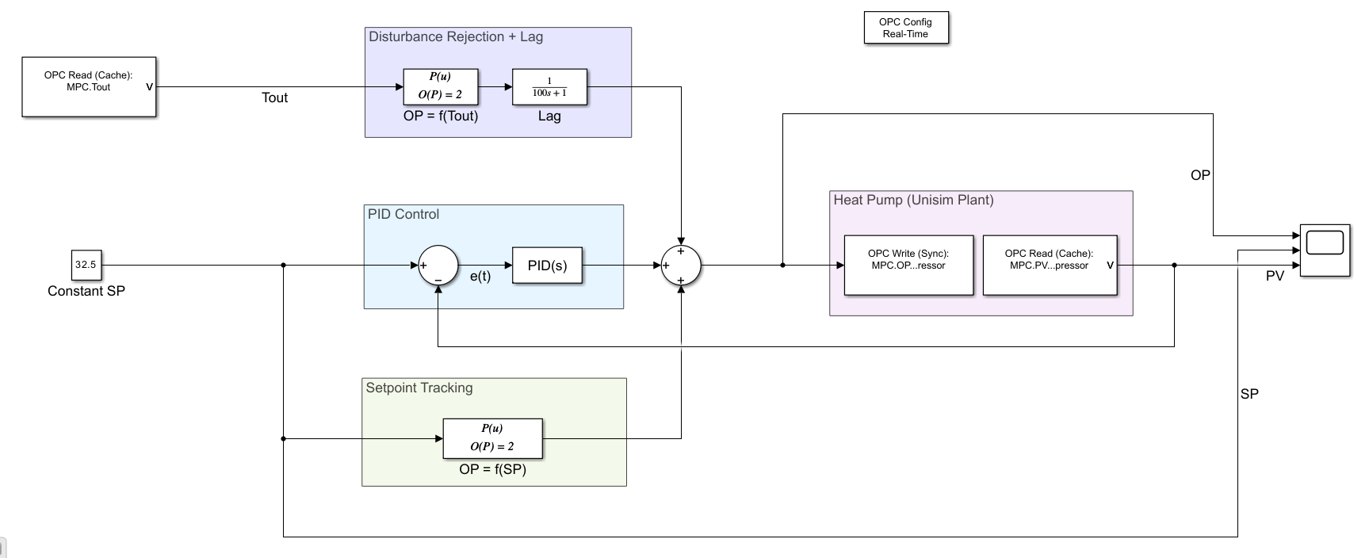
SIMULINK WITH OPC DA COMMUNICATION BLOCKS
Notes:
We are now ready to implement the developed PI Controller on the UniSim Plant model

Slide 29
SIMULATED BEHAVIOUR

Slide 30
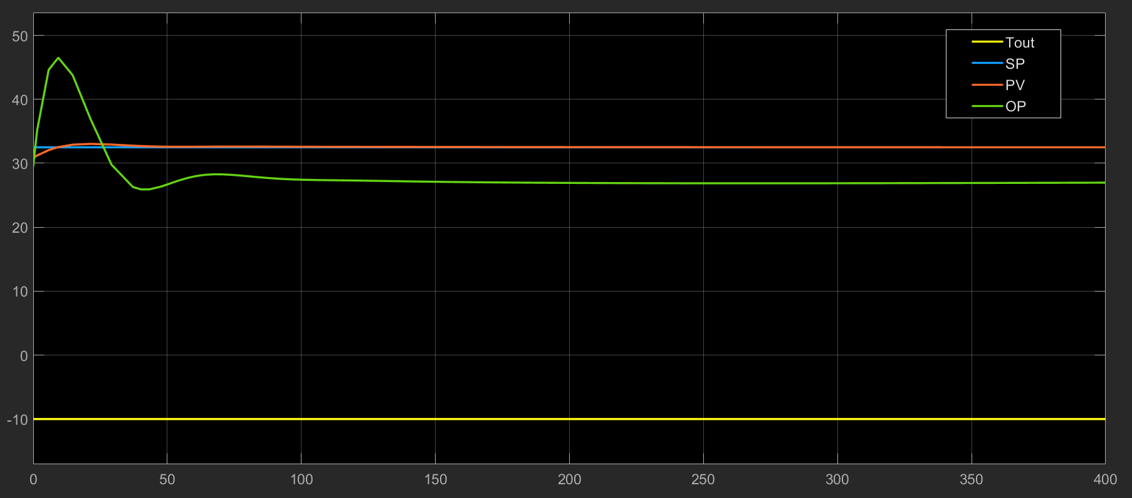




CONTROL ACTION
$$P=5$$
$$SP=32.5 ℃$$
$$I=3$$
$$T_{out}=−10 ℃$$

Slide 31
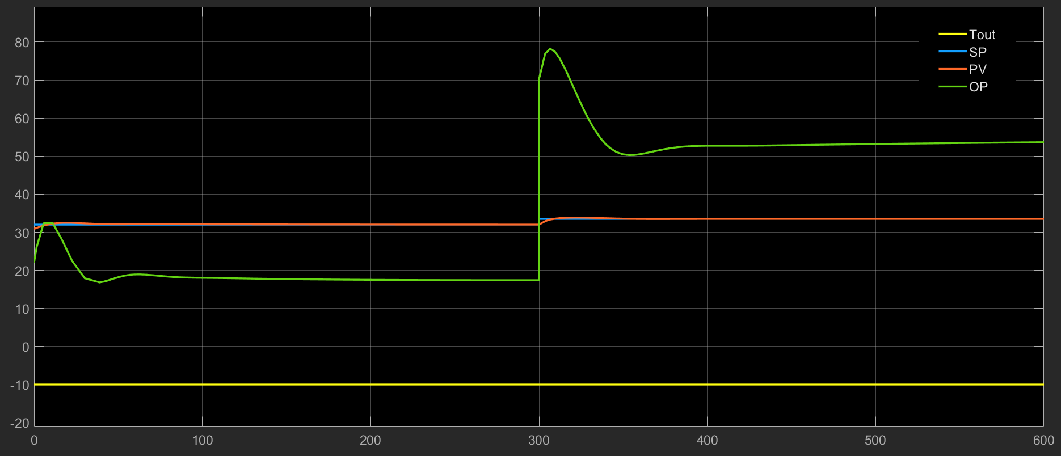


BEHAVIOUR AGAINST SETPOINT CHANGE
$$SP=32.5 ℃→33.0 ℃$$
$$T_{out}=−10 ℃$$

Slide 32
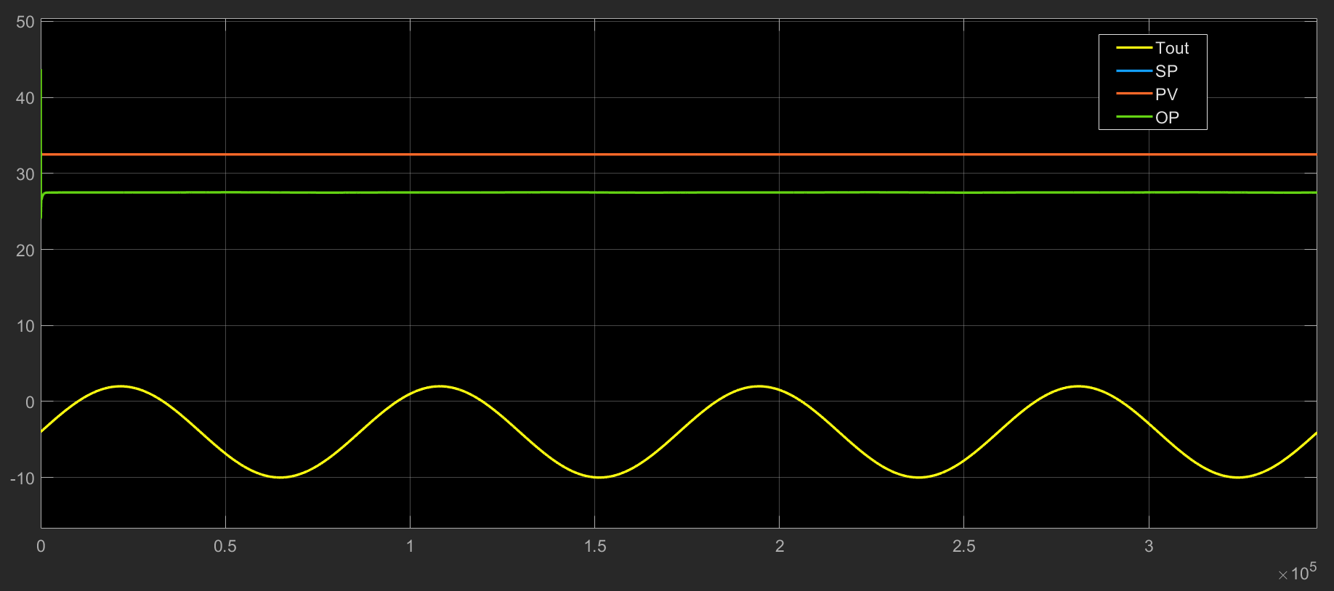

BEHAVIOUR AGAINST VARYING DISTURBANCE
$$SP=32.5 ℃$$
$$T_{out}=varying between−10 ℃ and 2 ℃$$

Slide 33
TESTING WITH THE REAL PLANT

Slide 34
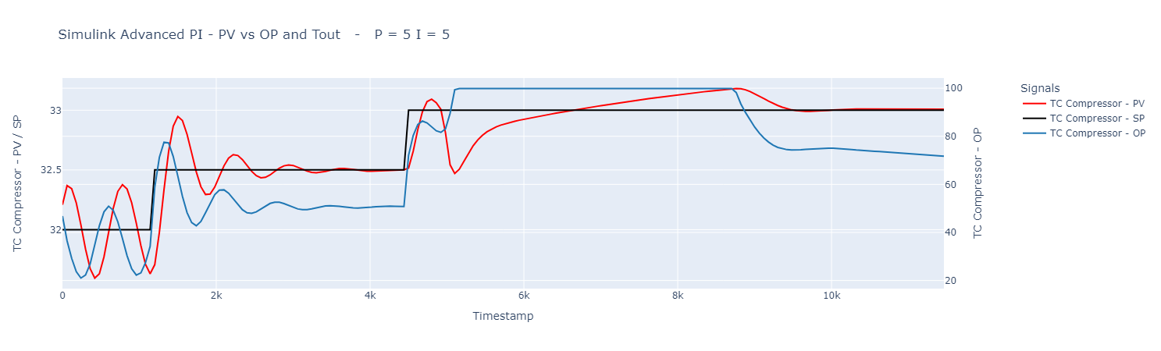
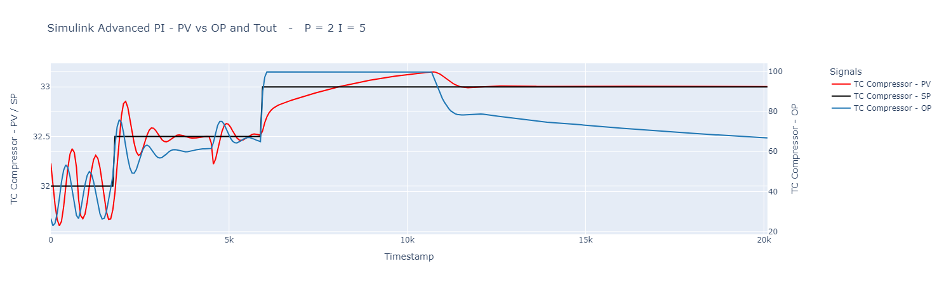
SIMULATION RESULTS – GAIN TUNING

Slide 35
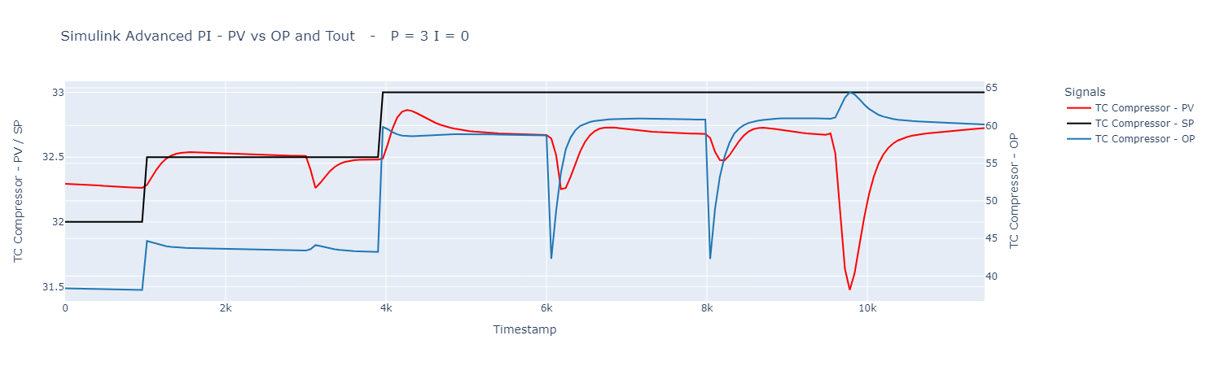
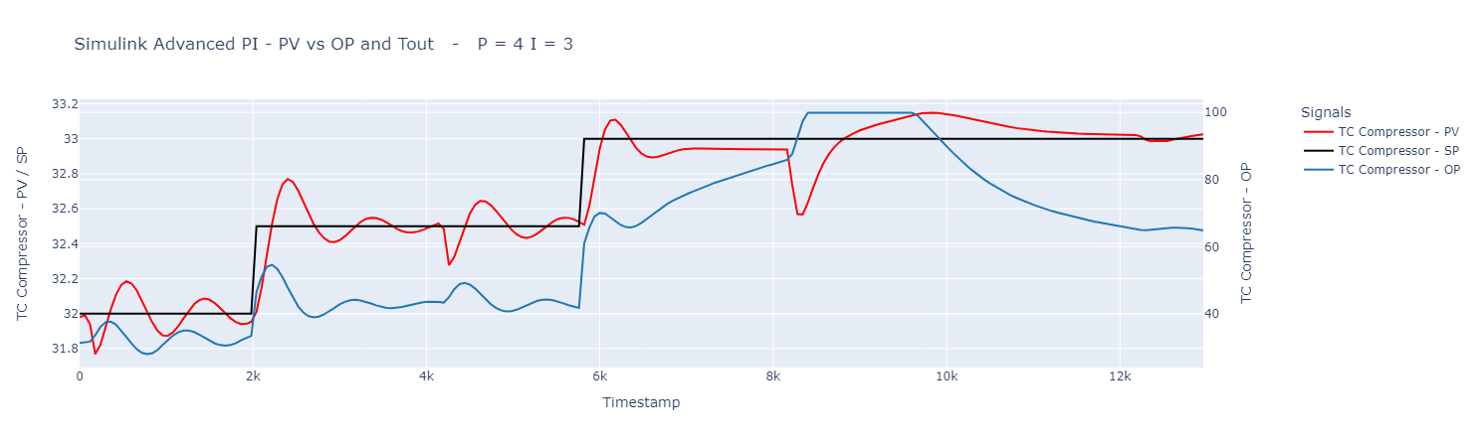
SIMULATION RESULTS – GAIN TUNING

Slide 36
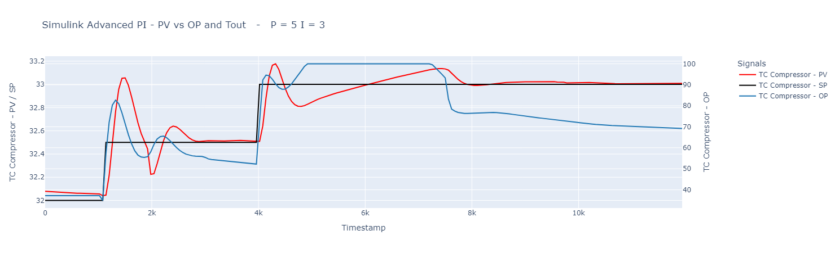
SIMULATION RESULTS – GAIN TUNING

Slide 37
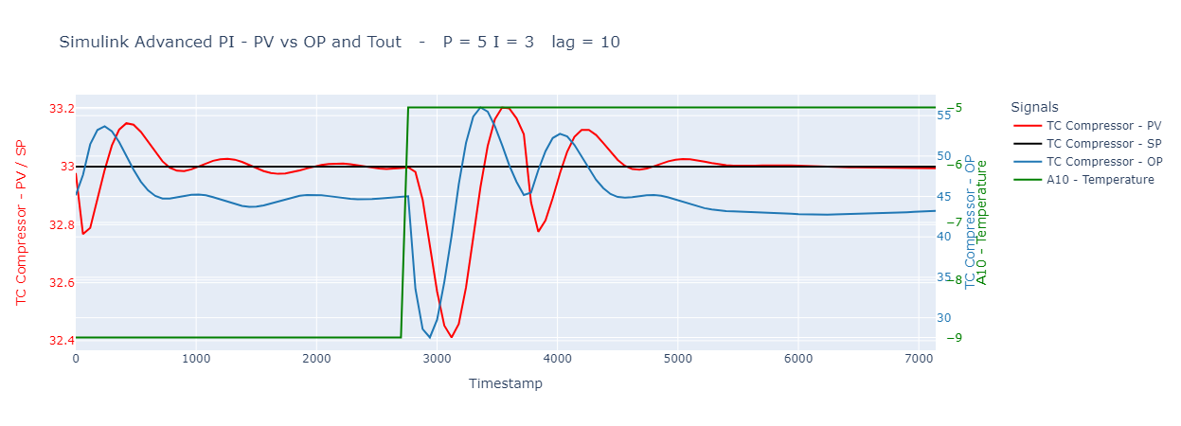
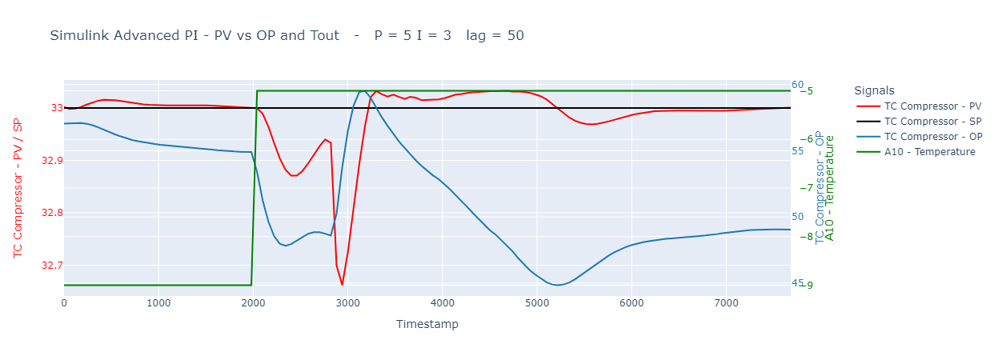
SIMULATION RESULTS – DIFFERENT LAG VALUES

Slide 38
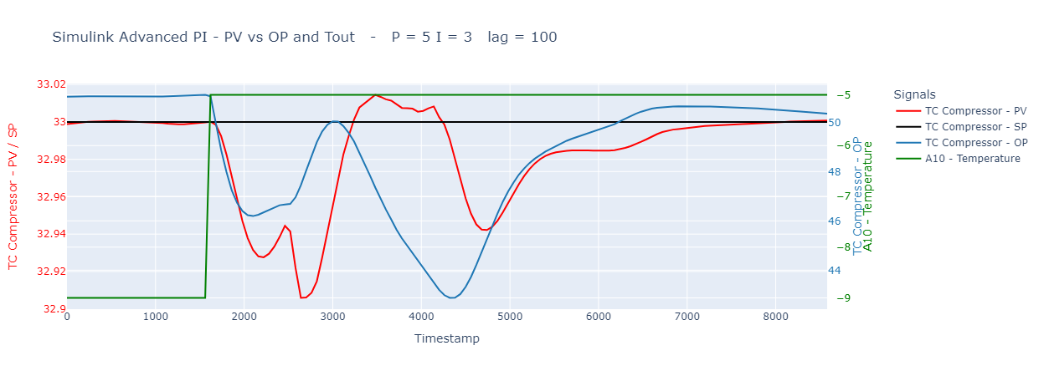
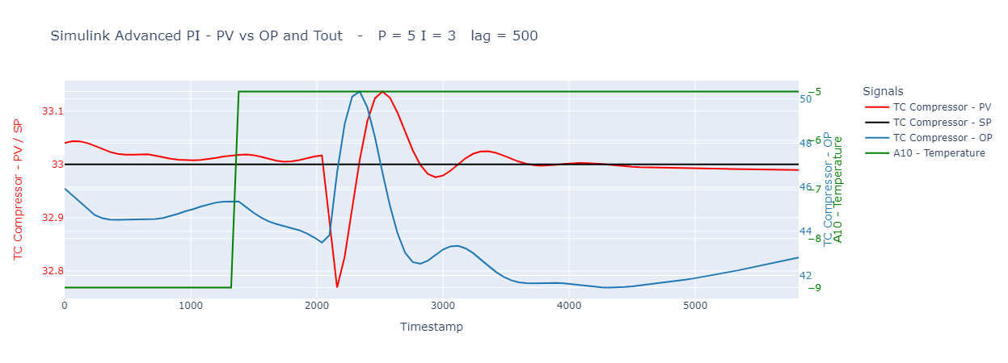
SIMULATION RESULTS – DIFFERENT LAG VALUES

Slide 39
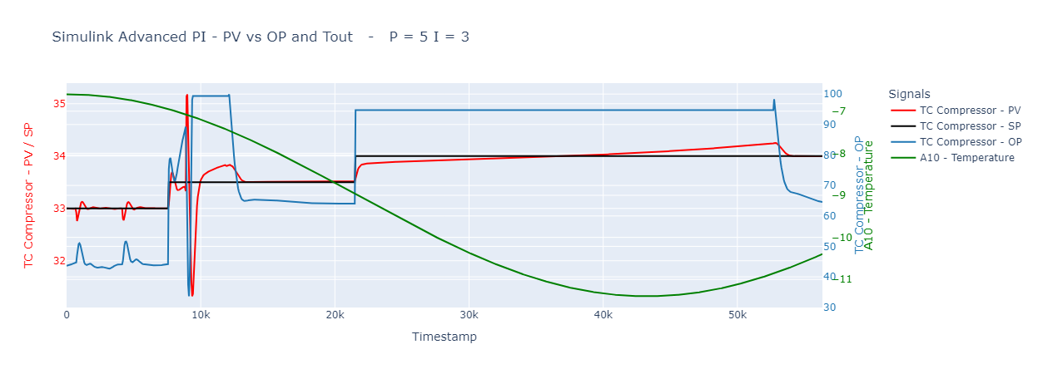
DAY/NIGHT SIMULATION

Slide 40
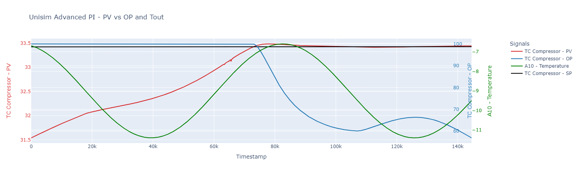
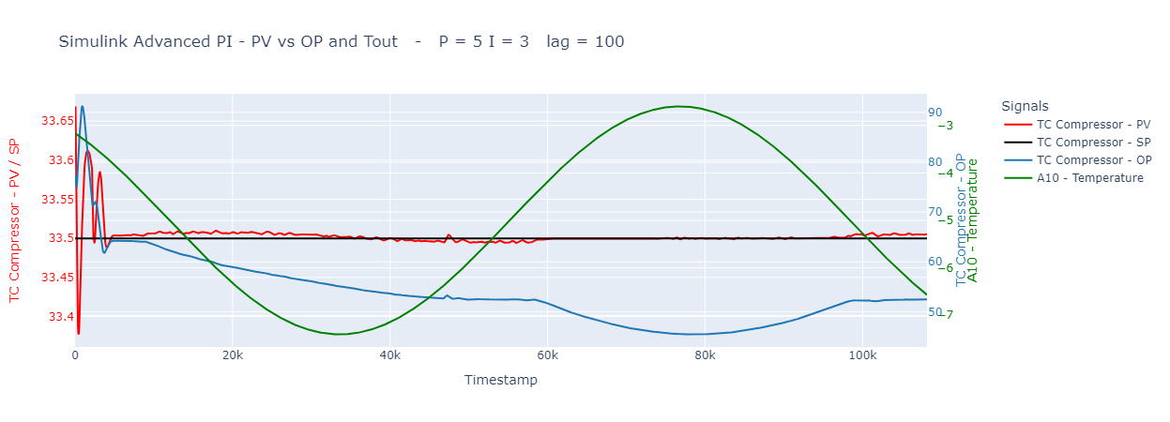
SIMULATION RESULTS – BEST PARAMETERS
UniSim
Simulink

Slide 41


THANK YOU

